Slide 1
Sever structure
EMS server functions as a logic and communications hub for the system. It’s responsible for preloading necessary resources and starting processes. It mainly consists of 5 threads:
Initializing connection to the SQL server.
Creating config file for Facial recognition and starting it.
Running system clock. It is responsible for timed events, like daily DB backup and fixing abnormalities in it.
Listening for client connections.
In addition the server features a custom terminal for IT department, that can accept several commands, like manual start and termination of FR, and manual SQL injections.
It also served as a debugging tool during development, by generating “valid” internal and state ids, and simulating a year of work for employees id the DB.

Slide 2
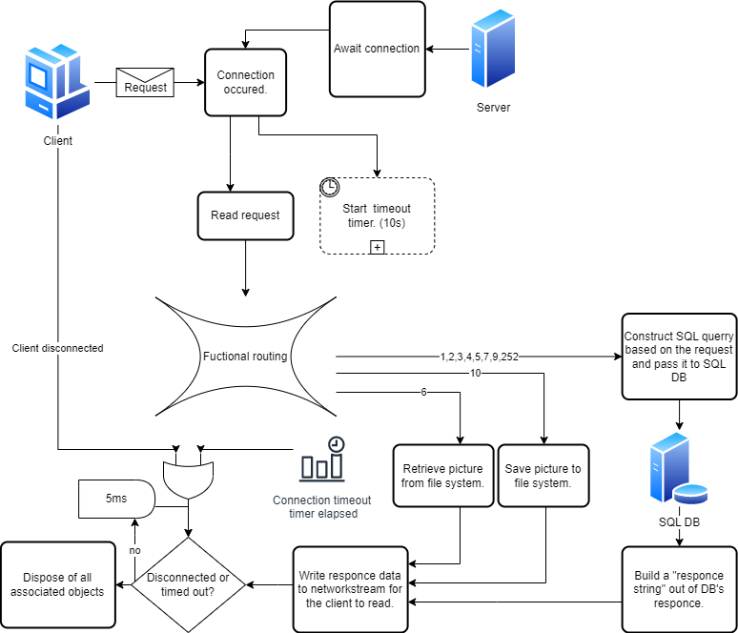
EMS Client-Server-DB communication structure

Slide 3
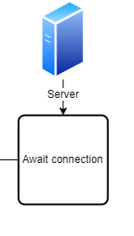
Client connection awaiter.
-Initially a thread being created, that listens for a connection. -When connection occurs, it’s handling passed to “Connection Manager”. -A new thread is created, that listens for a next connection.

Slide 4
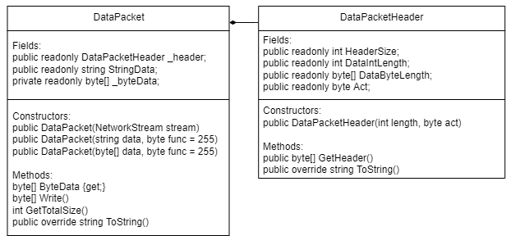
DataPacket structure
Both server and client making use of a custom structure called “DataPacket”. This structure handles data transformation from byte array used by TCP to more useful format. DataPacket consists of two parts: -DataPacketHeader: Contains length of the data as integer and a number of function for future routing by the server. -DataPacket body: Contains the data in string and byte[] formats.
-NetworkStream to DataPacket transformation is done by DataPacket(NetworkStream stream) constructor.
-Byte array for the writing is provided by “packet”.Write() method.

Slide 5
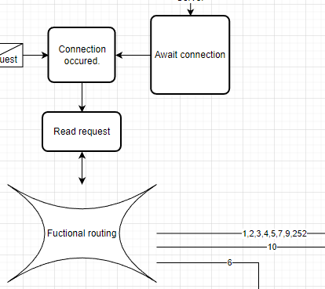
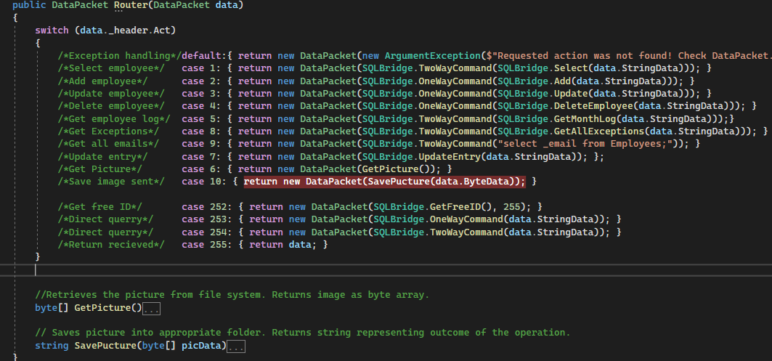
Processing requests
Received request is parsed to DataPacket structure and passed to server’s router.

Slide 6
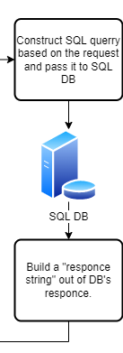
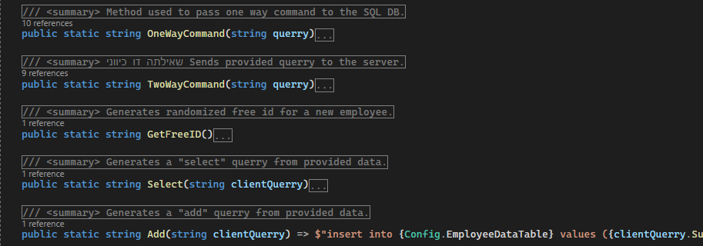
SQL Database communication
All of the communication with SQL Server is done within SQLBridge class. Firstly server router sends the request string to one of the “query forming” methods. Then it’s passing the response to either one way, or two way command functions. This depends on the nature of the request and whenever client expects data from the DB.

Slide 7
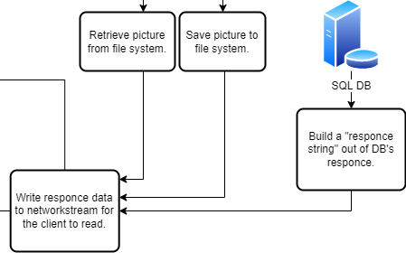
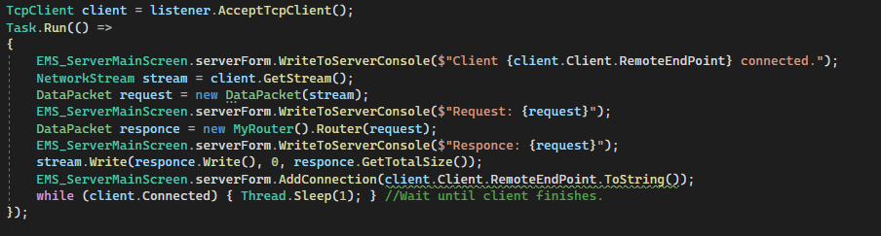
Response
When DB response is ready, everything cascades back, the response DataPacket is created and immediately sent back to the client.

Slide 8
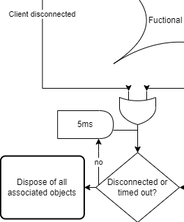
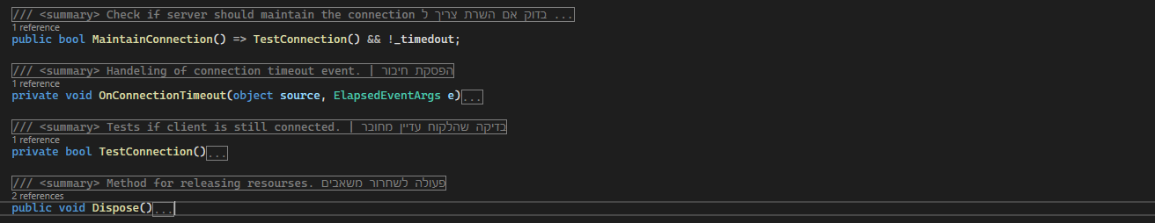
Connection closure.
After the response has been sent, the thread persists indefinitely, until either the TCPClient object status changes to disconnected, or OnConnectionTimeout event raised by _connectionTimeout timer. At that point, all of the objects associated with the connection will be finalized and disposed of.

Slide 9
Question so far?

